Slide 1
Welcome to Ilac ☺
Please pay attention…

Slide 2
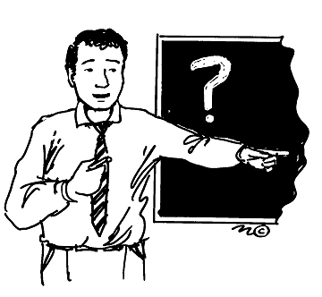
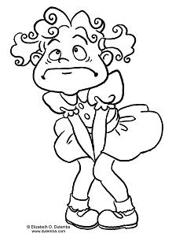
Important Phrases to remember
Blah blah blah …☺
No Spanish.. ☺
Teacher..ya no aguanto…. ☹
Profe…Baño…

Slide 3
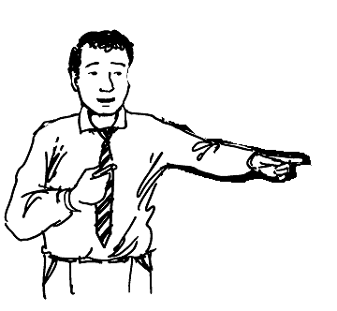
Correct way to ask…
May I go to the restroom, please ?
Excuse me, teacher.
Sure ☺
Yes ?

Slide 4

READ

Slide 5
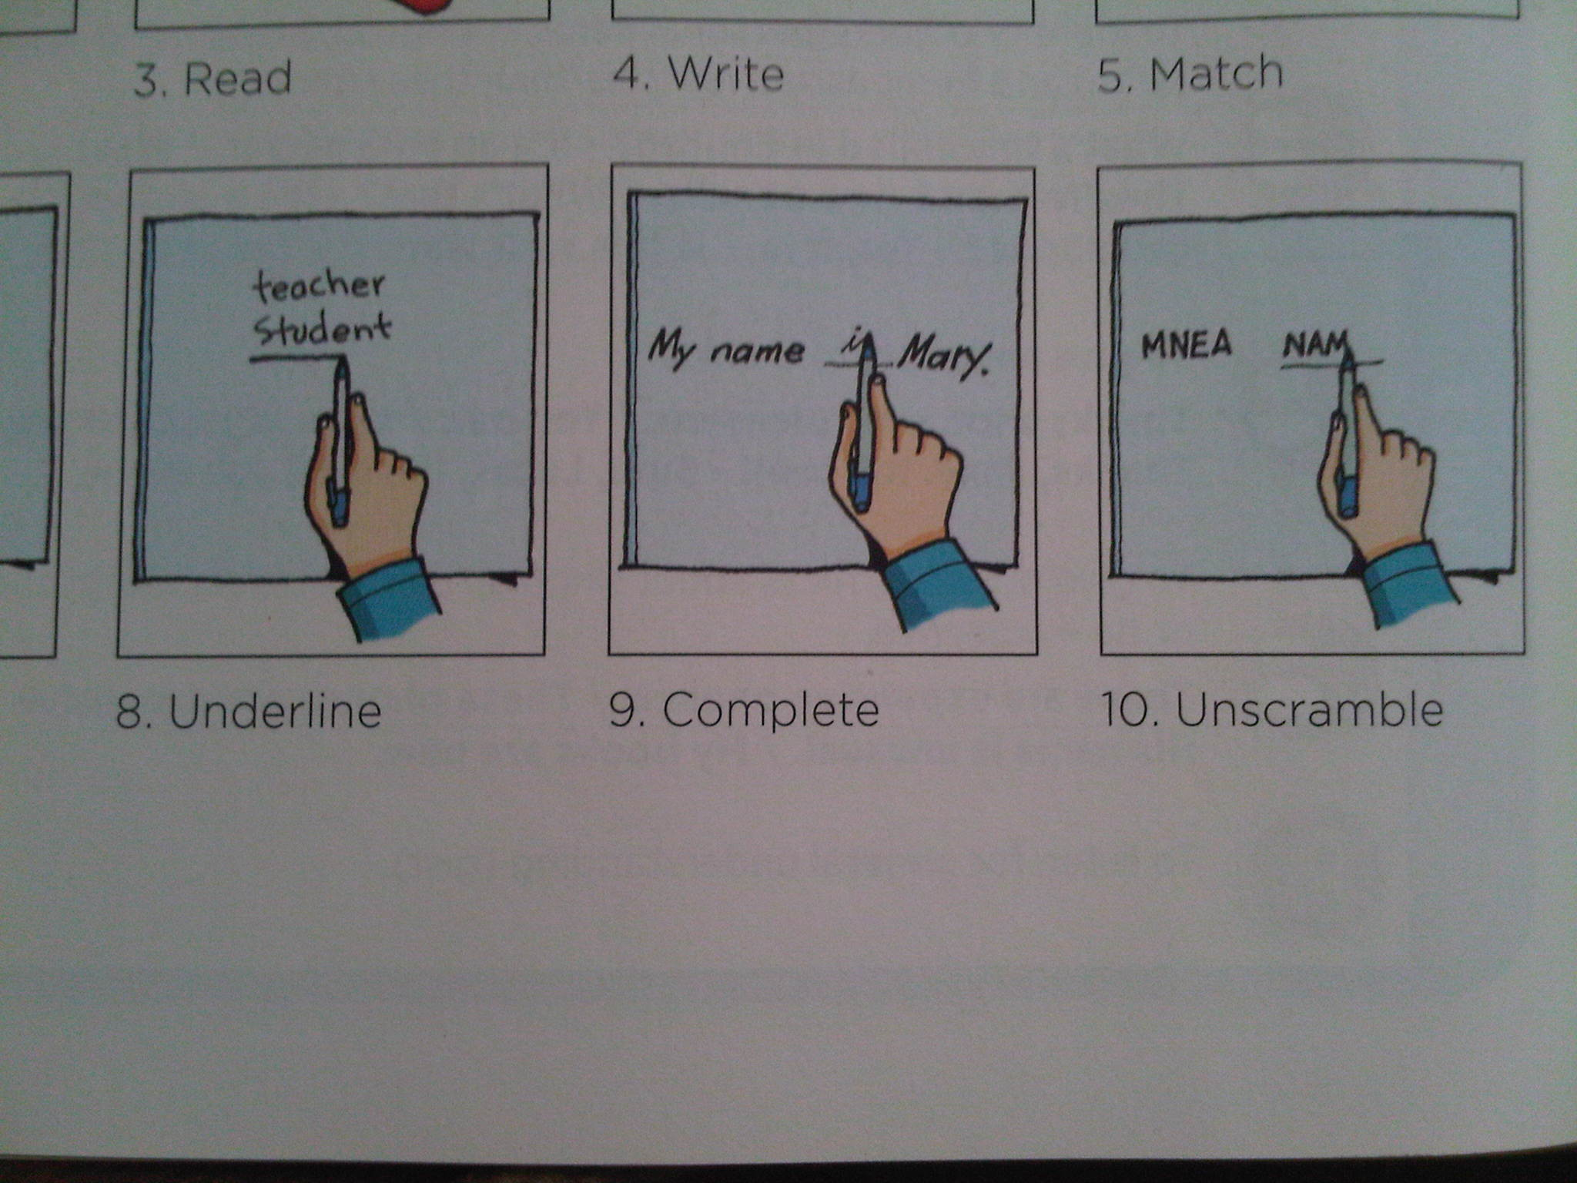
UNDERLINE

Slide 6

LISTEN

Slide 7
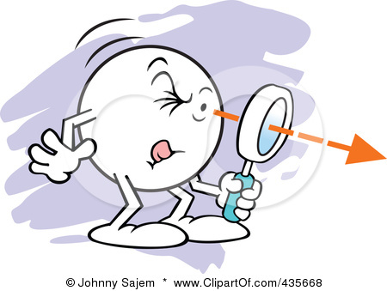
LOOK

Slide 8
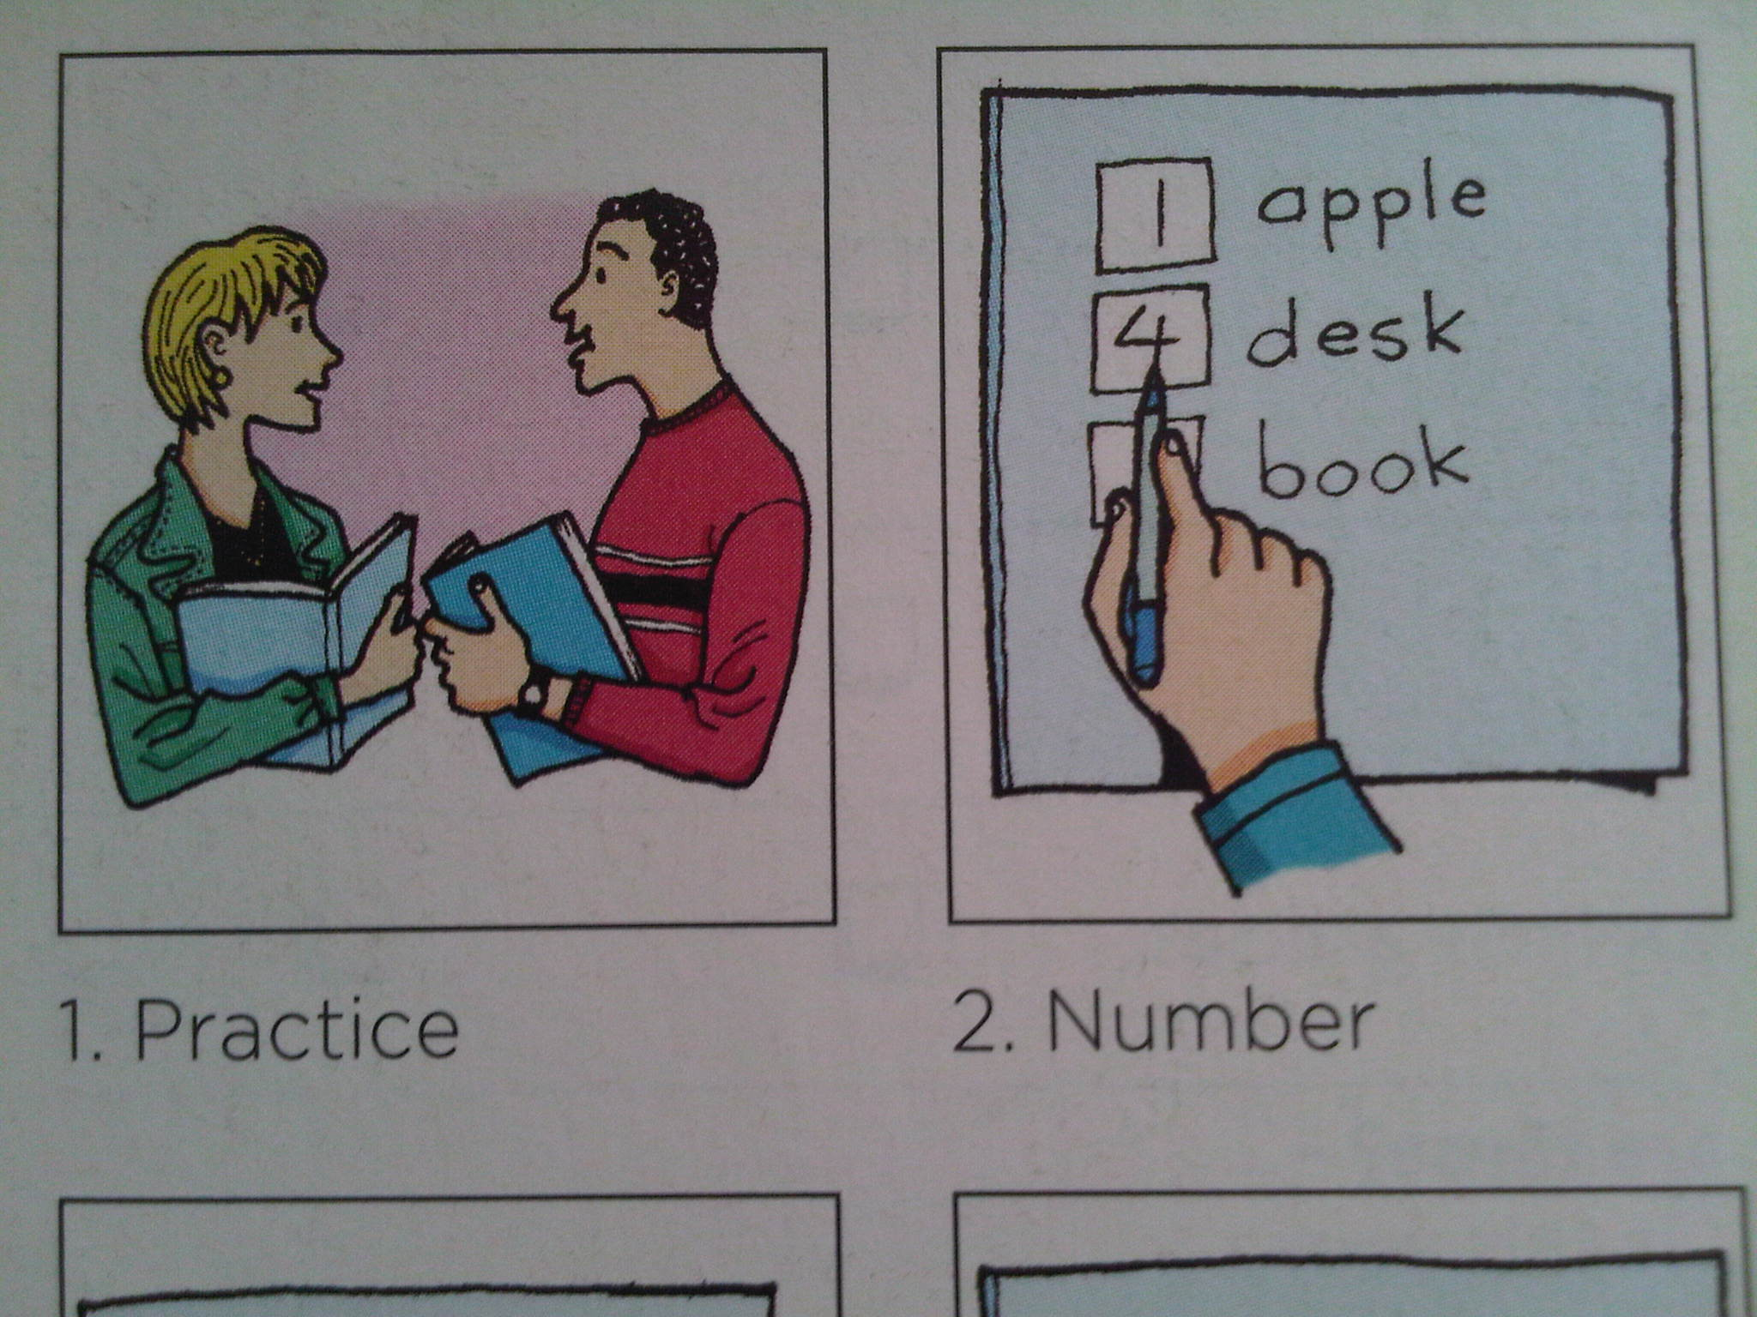
NUMBER

Slide 9

WRITE

Slide 10
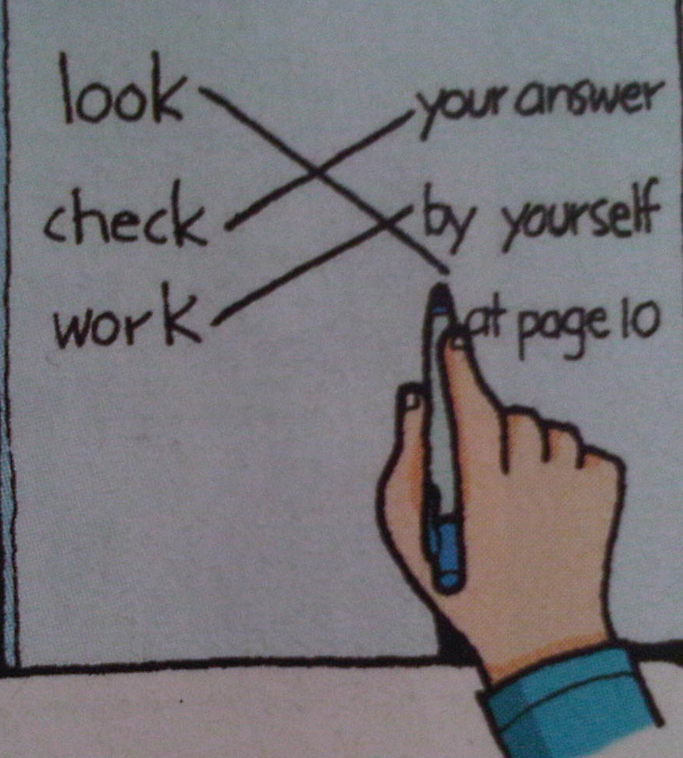
MATCH

Slide 11
Commands to remember…
Match
Age Juan
First name Garcia
E-mail Address 18
Last name 123@gmail.com
2
Age ___Juan
First name ___Garcia
E-mail Address ___ 18
Last name ___ 123@gmail.com
4
1
3
Unscramble
amNe
N
a
me

Slide 12
UNSCRAMBLE

Slide 13
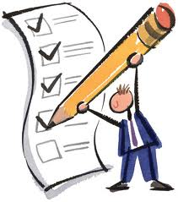
CHECK

Slide 14
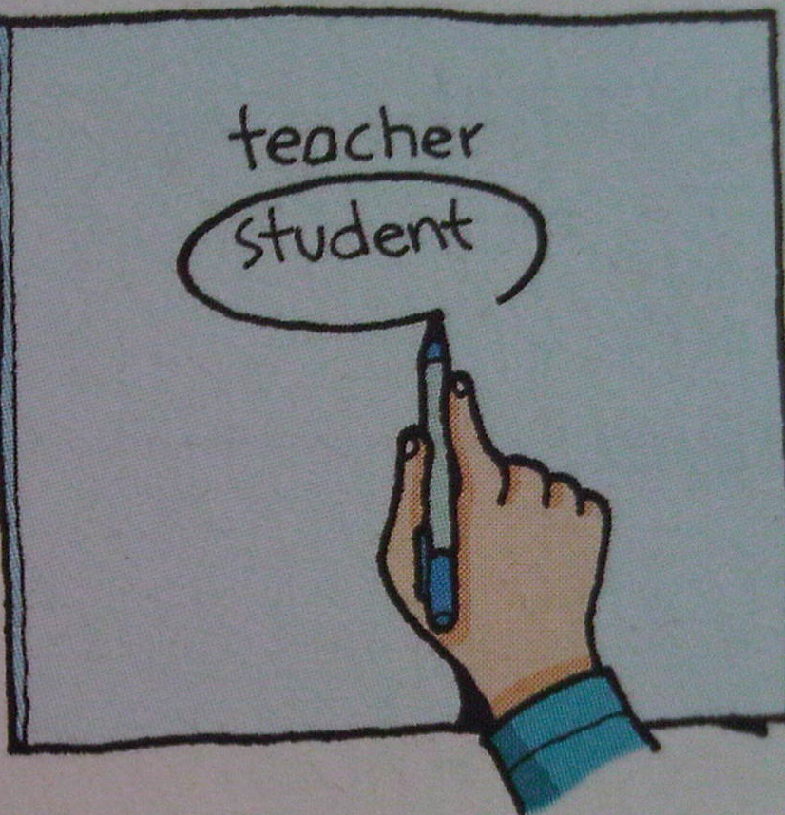
CIRCLE

Slide 15
PRACTICE

Slide 16
COMPLETE

Slide 17
Commands to remember…
2
Number
____ Hi, my name is Juan
____ Nice to meet you.
____ Hello, What’s your name?
____ Nice to meet you
3
1
4
Cross
Hello
Underline
Hello
Circle
Hello

Slide 18



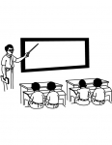
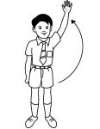
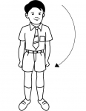
LISTEN ! OPEN YOUR BOOK! CLOSE YOUR BOOK!
RAISE YOUR HAND! PUT YOUR HAND DOWN! LOOK AT THE BOARD!

Slide 19

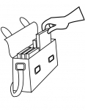
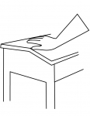
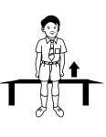

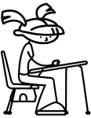
BE QUIET! TAKE OUT YOUR BOOK! TOUCH YOUR DESK!
SIT DOWN! STAND UP! WRITE YOUR NAME!

Slide 20
BASIC EVERYDAY EXPRESSIONS
Greetings
Hello!
Good morning!
Good afternoon!
Good evening! 18:45 pm
Farewells
Bye!
Good bye!
See you tomorrow!

